Slide 1


RFID Security
Aamer Shah
Vinod Kumar Shrimali
RFID
Radio Frequency Identification
@NullDubai

Slide 2


About Us
Disclaimer
The main objective of this presentation is demystify the “security” of Mifare Classic cards showing how easy is dump, modify and rewrite the content of the card. This PPT isn’t pretend incentive frauds or criminal activities. The authors are not responsible by the use of the presented content to do illegal actions. If you want use this knowledge to do it, do it by your own risk!
Vinod Shrmali
contact@vinodshrimalii.com
Etisalat Security / Red-Team
Twitter.com/vshrimalii
Aamer Shah
null@AamerShah.com
Etisalat Security / Red-Team
Twitter.com/Aamer_Sha

Slide 3

Section Divider
Introduction to RFID
Generic Attack
MIFARE Classic Arch.
CARD Cloning
Defenses
Demo

Slide 4
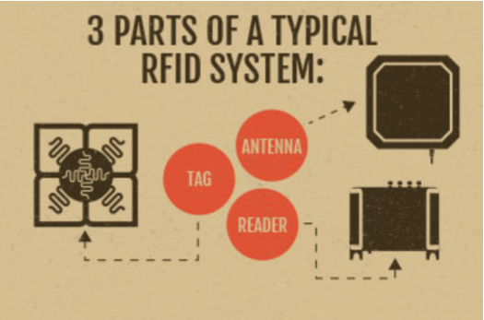
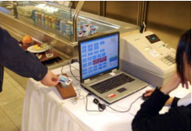
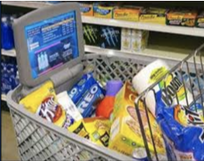
Introduction to RFID
Radio Frequency Identification (RFID)
A technology used for electronic and wireless identification of objects, humans and animals
It use Radio Frequency to transfer data between reader and object
RFID can be both
Active tags
Passive tags
Notes:
A/c tag (Powered by an internal battery, Finite lifetime, High range)
P/C tag w/o battery, less expensive, infinite life, need more powerful reader, Orientation sensitivity)
RFID is the process by which items are uniquely identified using radio waves. n RFID system comprises A tag, A antenna, A Reader.
Near-field communication devices operate at the same frequency (13.56 MHz) as HF RFID readers and tags.An NFC device is able to act both as a reader and as a tag

Slide 5
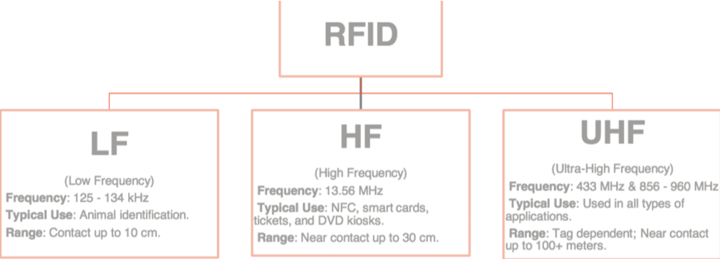
Cont..
Freq = Data Rate

Slide 6

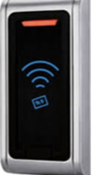
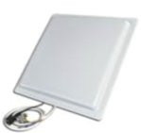
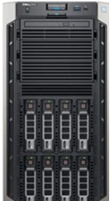
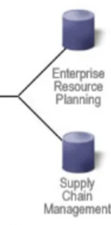
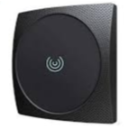
How RFID Works
The reader sends beacon broadcasts to tags, The radio waves from the readers power up the tags ,The tags will respond to the beacons
RFID Tags
RFID Reader
Local Server
ERP/Supply chain

Slide 7
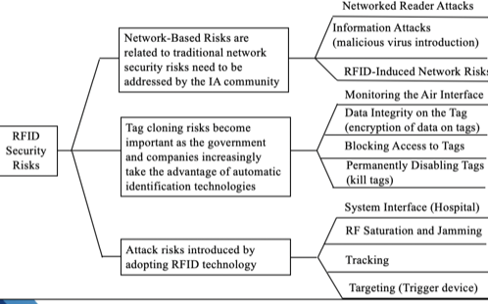
Generic Attack
Card Cloning (Counterfeiting the identity of reader and unauthorized writing in card )
Unauthorized Read/Write of Tag Data
Insertion of Rogue/Counterfeit Tags
Degradation of Tag Data Collection
Sniffing
Replay / Spoofing attack
DOS /Jamming RFID freq
Factory reset / deletion of tag

Slide 8

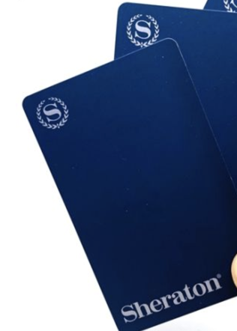
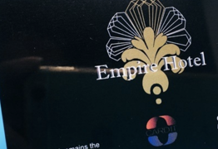


MIFARE Classic
MIFARE Classic is contactless smart ticket ICs operating in the 13.56 MHZ frequency range with read/write capability and ISO 14443 compliance.
The Mifare Classic cards was created by a company called NXP Semiconductors
Unique Identifier (UID) is read-only • Authentication between the tag and reader to share a session key.
MIFARE Classic EV1 represents the highest evolution of the MIFARE Classic product family
Unique Identifier (UID) is read-only • Authentication between the tag and reader to share a session key. • CRYPTO1 cipher algorithm is proprietary and not shared with public (security by obscurity). • Obfuscated parity information. • Only implemented in hardware

Slide 9
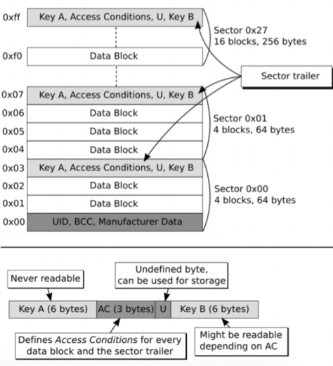
MIFARE Arch.
Each Block has 16 Byte
The first block of sector 0 contains the UID, BCC and Manufacturer Data (read-only)
Block (0) always read first by Encoder use to identify tag
The Access Conditions determine the permissions in each block(Most of the case block 16).

Slide 10
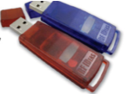
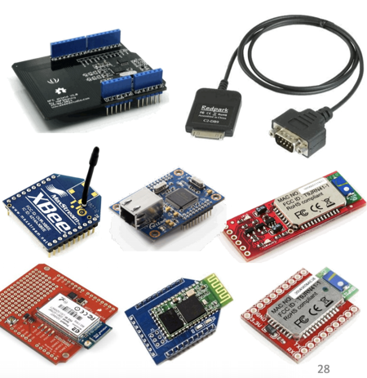
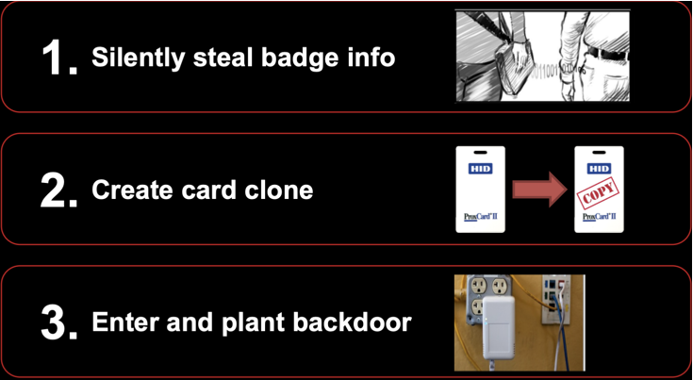
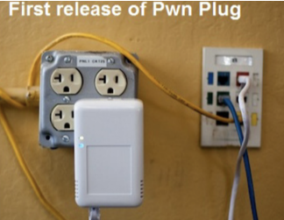
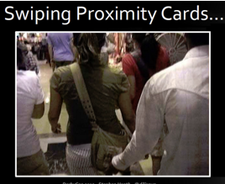
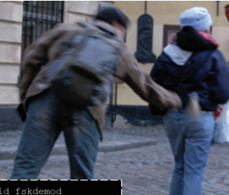
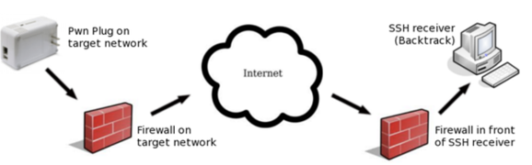
Card Cloning
Tools
Mobile App : Mifare Classic tool, NFC Proxy
EMVemulator, Mifare Desire, Credit Card Simulator
H/W: Proxmark3, Hfenz, and RFID Reader, RFID IOT Script, PC/SC reader, NFC reader, ProX Brute, RFIDes Tool, Tastic Thief (long range), cloning badge
Maintain access: Pwn Plug{h/w} (s/w pwnexpress)
Task Writing: Smart NFC, NFC R/W, Tag writer etc.
←Success
Fail→

Slide 11
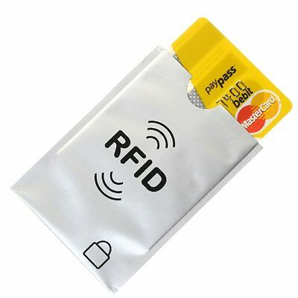
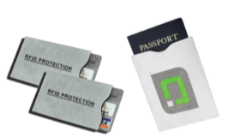
Defenses
The unique effective solution is exchange all cards in circulation by more secure cards. (Ex: Mifare Plus/DESfire) Other approaches are only workarounds.
Disable write access on card, use proper encoder
Utilize RFID card shields when the badge is not in use to prevent drive-by card sniffing attacks.
Employ the tamper detect mechanisms to prevent badge reader physical tampering. All readers and doors should be monitored by CCTV
Ensure that visitor cards and actual employee card are isolated in terms of technology.
Consider systems that also support 2-factor authentication, using elements such as a PIN pad or biometric inputs.
“Never believe any tool which claim card cloning”

Slide 12
Our team has made small demonstration that how an attacker can get unauthorized access to restricted area by card cloning without using
any dedicated hardware (mostly helpful in Red-Team activity)

Slide 13

Thank You.
aamer@aamershah.com
vinod@vinodshrimalii.com
Do not ask me ? 🤣🤣

